Slide 1

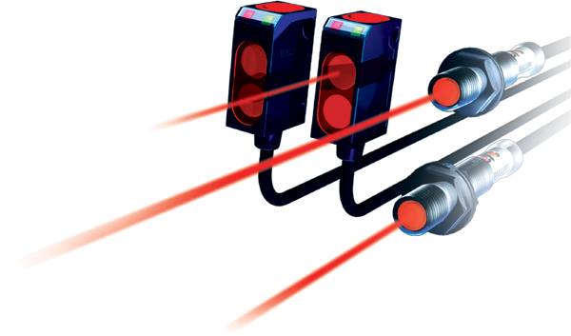
Training Series: Level I
Level I

Slide 2
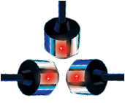
Electrical Interface
The Back-end

Slide 3
Electrical Interface
Electrical Interface
Divided into 2 areas:
  Operating voltage
  Output signal type
Power
Signal

Slide 4
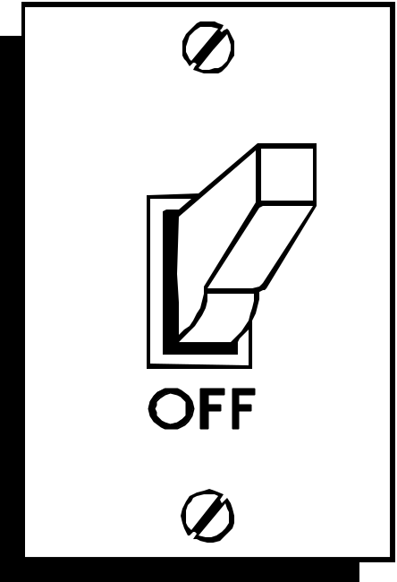
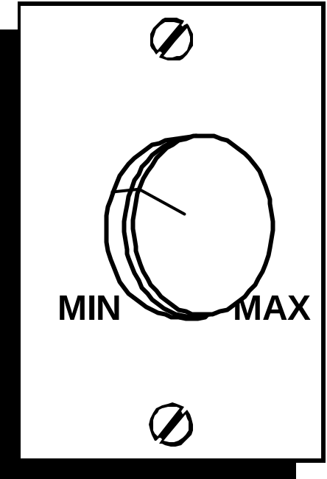
Electrical Interface
OUTPUT SIGNAL TYPES
Discrete
  ON or OFF
  YES or NO
Analog
  Speed control
  Position information
Signal

Slide 5
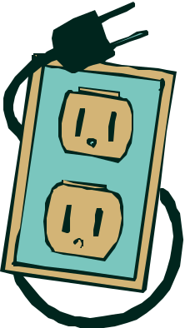
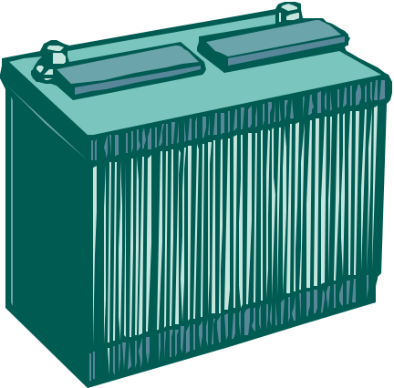
Electrical Interface
OPERATING VOLTAGE
Direct Current (DC)
  Current flows in only ONE direction
  Safe, easy-to-handle power source
Alternating Current (AC)
  Current changes direction 60 times a second
  Readily available
Power

Slide 6
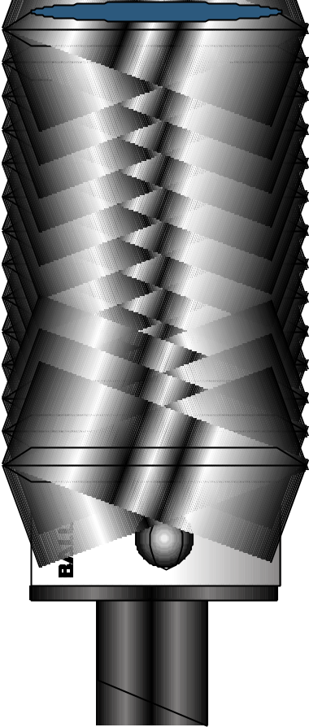
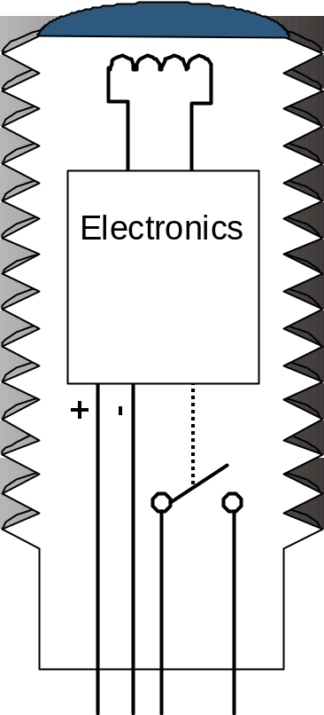
Electrical Interface
A DISCRETE
SENSOR IS A SWITCH
Electronics
Sensing Side
Front-end
Switch
Power Wires

Slide 7
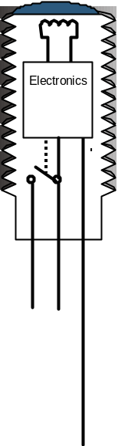

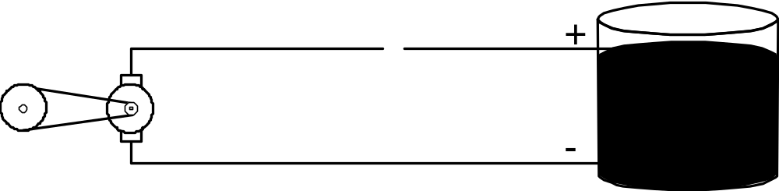

Electrical Interface
BASIC SENSOR CIRCUIT
Sensors with relay output
Unlike a switch, sensors require power to operate

Slide 8
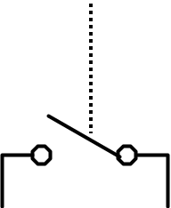
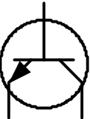
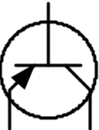

Electrical Interface
TYPES OF DISCRETE ELECTRICAL OUTPUTS
Sensors of today use Solid-State outputs, not mechanical relays
      Today Yesterday
  PNP, 3-wire Relay
  NPN, 3-wire
  AC/DC, 2-wire

Slide 9
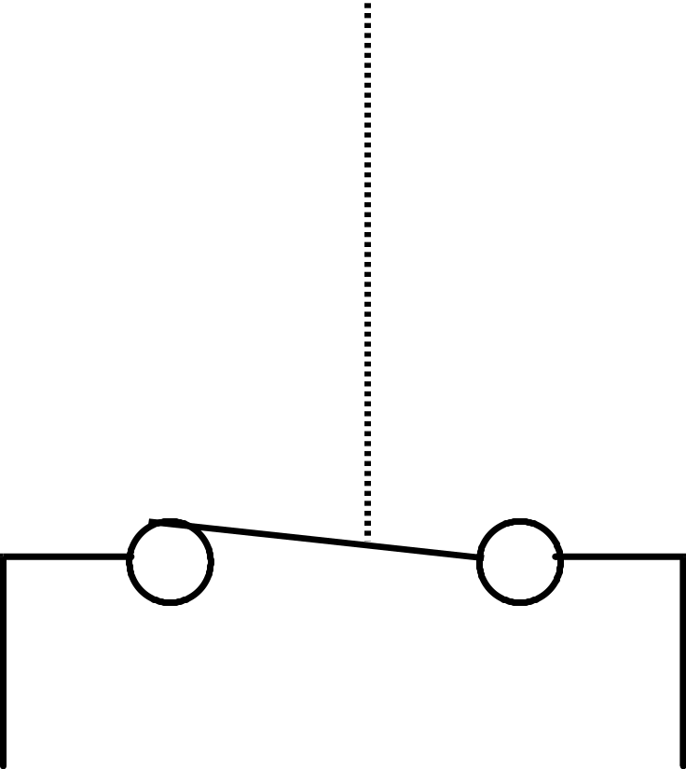
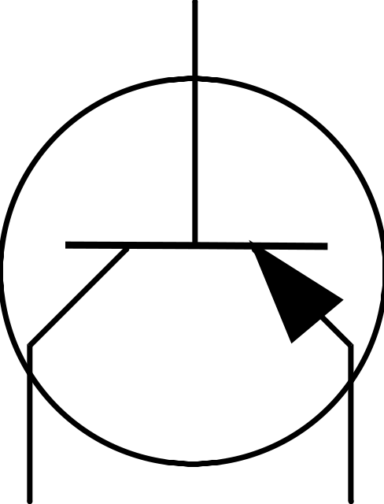
Electrical Interface
THE NPN & PNP OUTPUT
Functions similar to a switch,
  But current only flows in one direction
PNP
Transistor
Mechanical
Switch

Slide 10
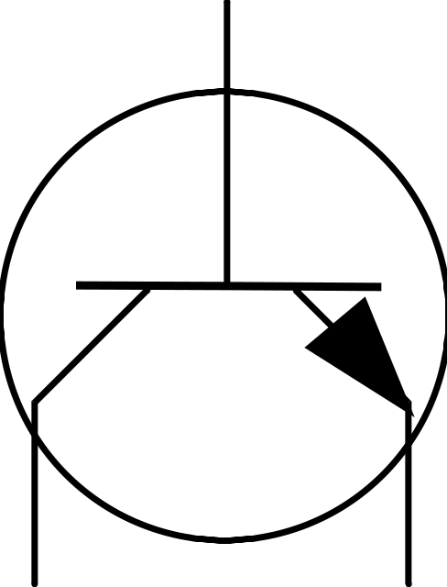
Electrical Interface
THE DIFFERENT TRANSISTORS
What direction do you want current to flow?
NPN
Also called Sinking
PNP
Also called Sourcing
+
-
-
+

Slide 11
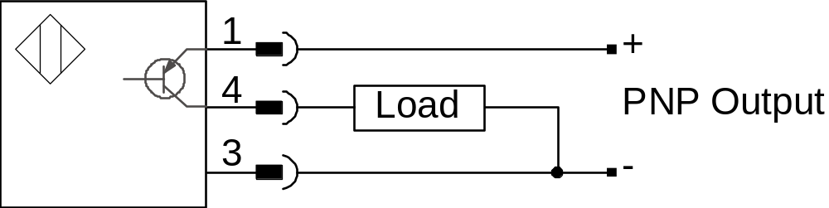
Electrical Interface
PNP, 3-WIRE
Standard diagram form
      As shown in our catalog
The Sensor
The Load
Connector
Pins

Slide 12
Electrical Interface
PNP, 3-WIRE
Watching the current flow
Sensors Power
Output Signal

Slide 13
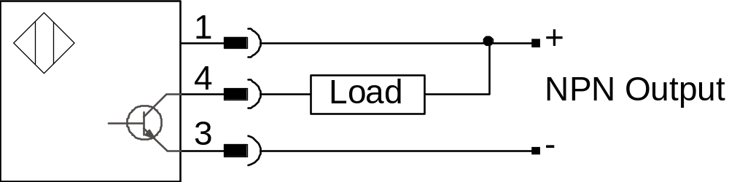
Electrical Interface
NPN, 3-WIRE
Watching the current flow
Sensors Power
Output Signal

Slide 14
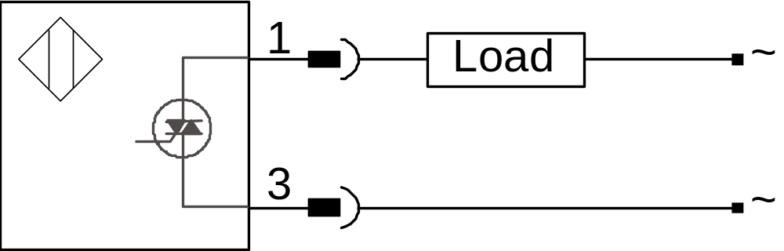
Electrical Interface
THE 2-WIRE AC/DC OUTPUT
Functions similar to a switch,
  But with a small leak
Sensors Power
Supply from leakage current
Triac
Output Signal

Slide 15
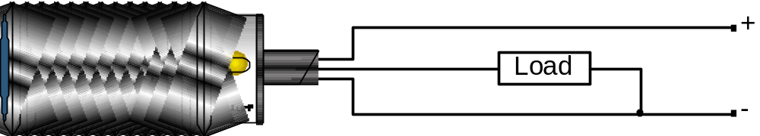
Electrical Interface
QUICK REFERENCE:
WIRING PNP & NPN
Second side of load
First side of load
Switched side
N P N
P N P
Sensor is PNP
Positive
Negative

Slide 16
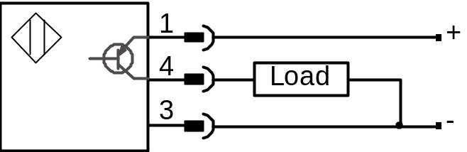
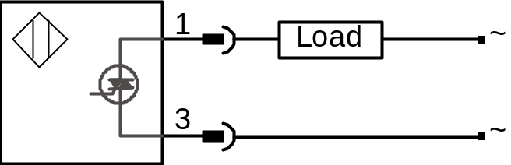
Electrical Interface
IF GIVEN A CHOICE, WHICH DISCRETE SENSOR TYPE SHOULD I CHOOSE?
1st CHOICE
2nd CHOICE
PNP or NPN, 3-wire
Fewer interface problems
Largest selection
- Lowest unit costs
AC/DC, 2-wire
- Many interface issues
Smaller selection
Susceptible to noise

Slide 17
Electrical Interface
NORMALLY OPEN (NO)
VS.
NORMALLY CLOSED (NC)
Identifies the non-active state (target not present) of the sensor
  Is it off (open)?
  Is it on (closed)?
Normally Open

Slide 18
Electrical Interface
NORMALLY OPEN (NO)
VS.
NORMALLY CLOSED (NC)
Identifies the non-active state (target not present) of the sensor
  Is it off (open)?
  Is it on (closed)?
Normally Closed

Slide 19
Electrical Interface
ANALOG OUTPUTS
Unlike a discrete output with two defined states, analog signals have an infinite number of states.
Discrete
Voltage
On
Off
Time
Analog
Voltage
Max
Min
Time

Slide 20
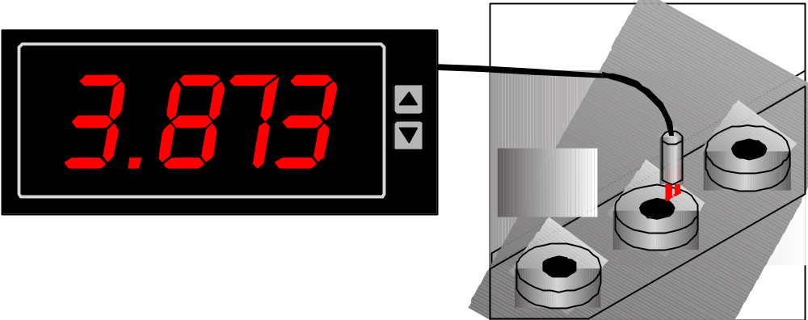
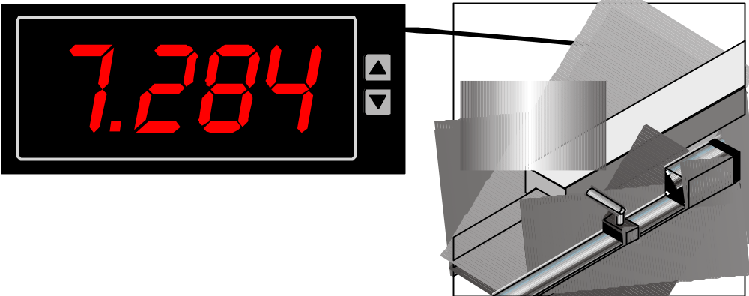
Electrical Interface
ANALOG USES
To provide absolute measurement or position information
Measurement
Position

Slide 21
Electrical Interface
ANALOG APPLICATIONS!
  Spool diameter
  Rotational position
  Liquid level
  Sort parts
  Determine part orientation
  Measure vibration
  Measure straightness
  Hydraulic or pneumatic
  cylinder position
Expanding
possibilities

Slide 22
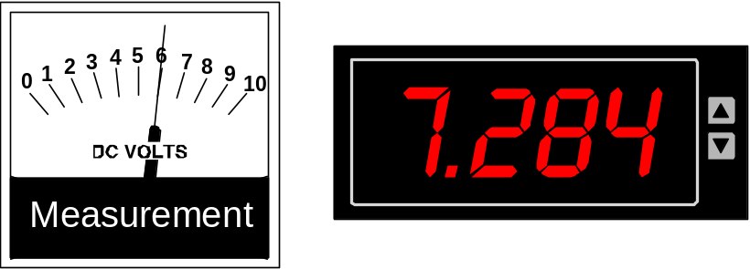
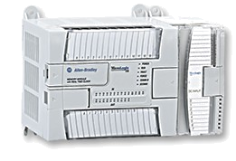
Electrical Interface
ANALOG DATA
  Panel meters
  Control systems

Slide 23
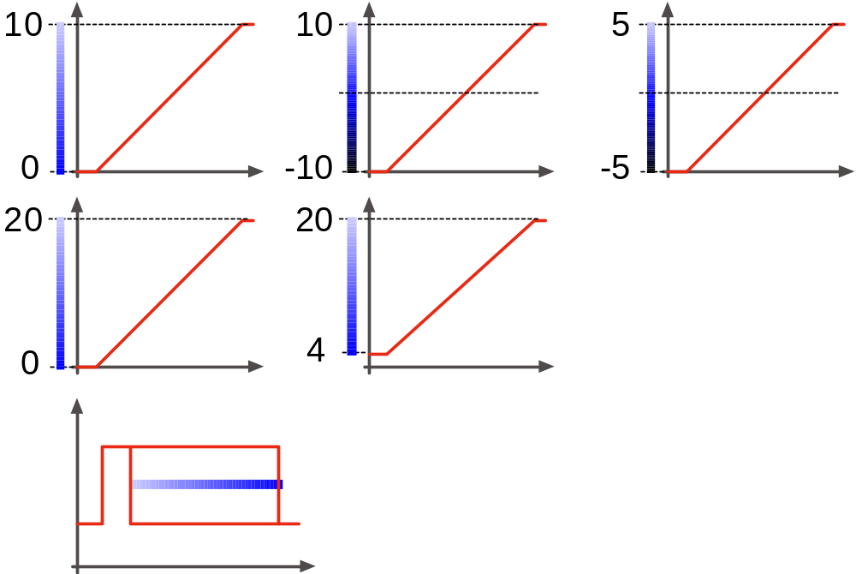
Electrical Interface
ANALOG INFORMATION
The many forms for representing measurement or position information
Voltage
Current
Digital Pulse

Slide 24



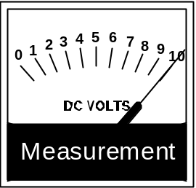
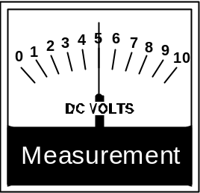
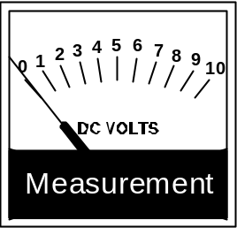
Electrical Interface
ANALOG VOLTAGE
Information contained in varying voltage
Maximum Voltage
Half Voltage
No Voltage
Water Analogy
Volt Meter

Slide 25



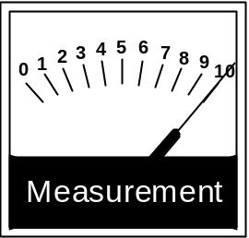
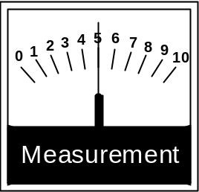
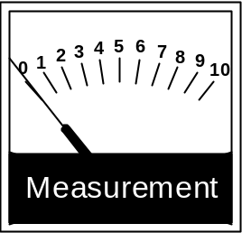
Electrical Interface
ANALOG CURRENT
Information contained in varying Current
Maximum Current
Half Current
No Current
Water Analogy
Current Meter

Slide 26
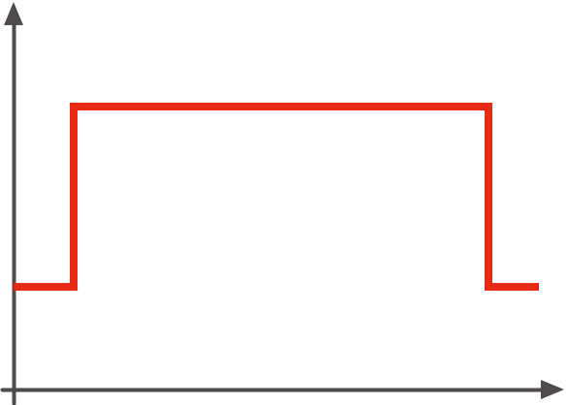
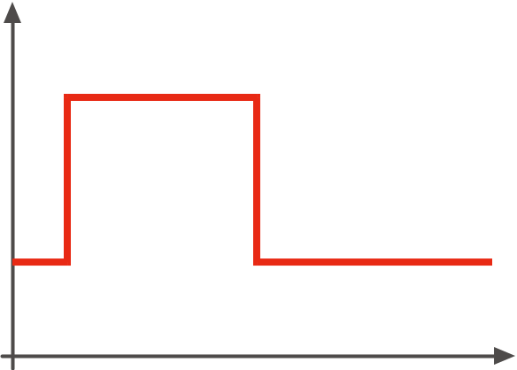
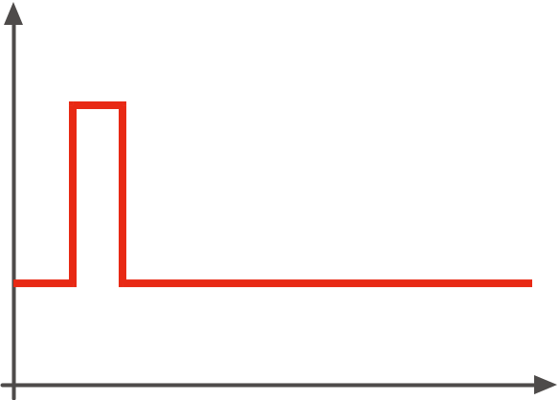

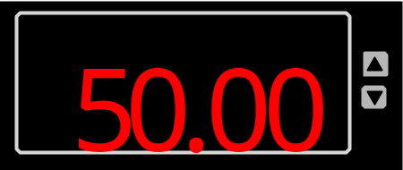
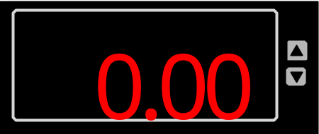
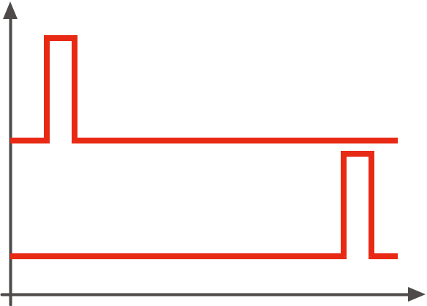
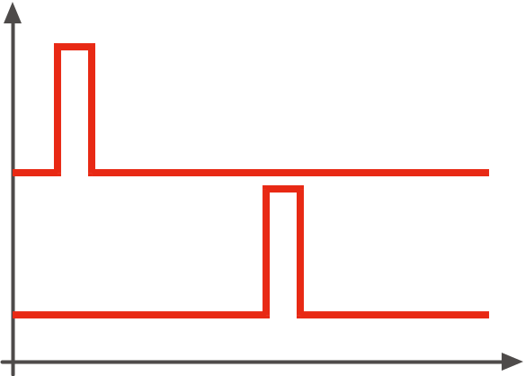
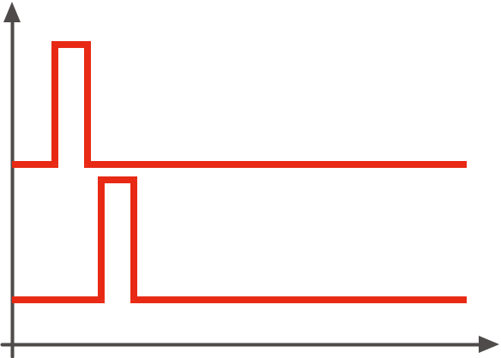
Electrical Interface
DIGITAL PULSE
Information contained in digital pulse timing
Maximum measurement
Half way
Minimum measurement
Pulse Width
Meter
Start/Stop

Slide 27
Electrical Interface
ELECTRICAL INTERFACE REVIEW
Operating voltage: Sensor Power
  DC: Safest
  AC: Most available
Output signal types
  Discrete
    PNP, 3-wire
    NPN, 3-wire
    AC/DC 2-wire
  Analog
    Voltage
    Current
    Digital pulse
Power
Signal

